Slide 1
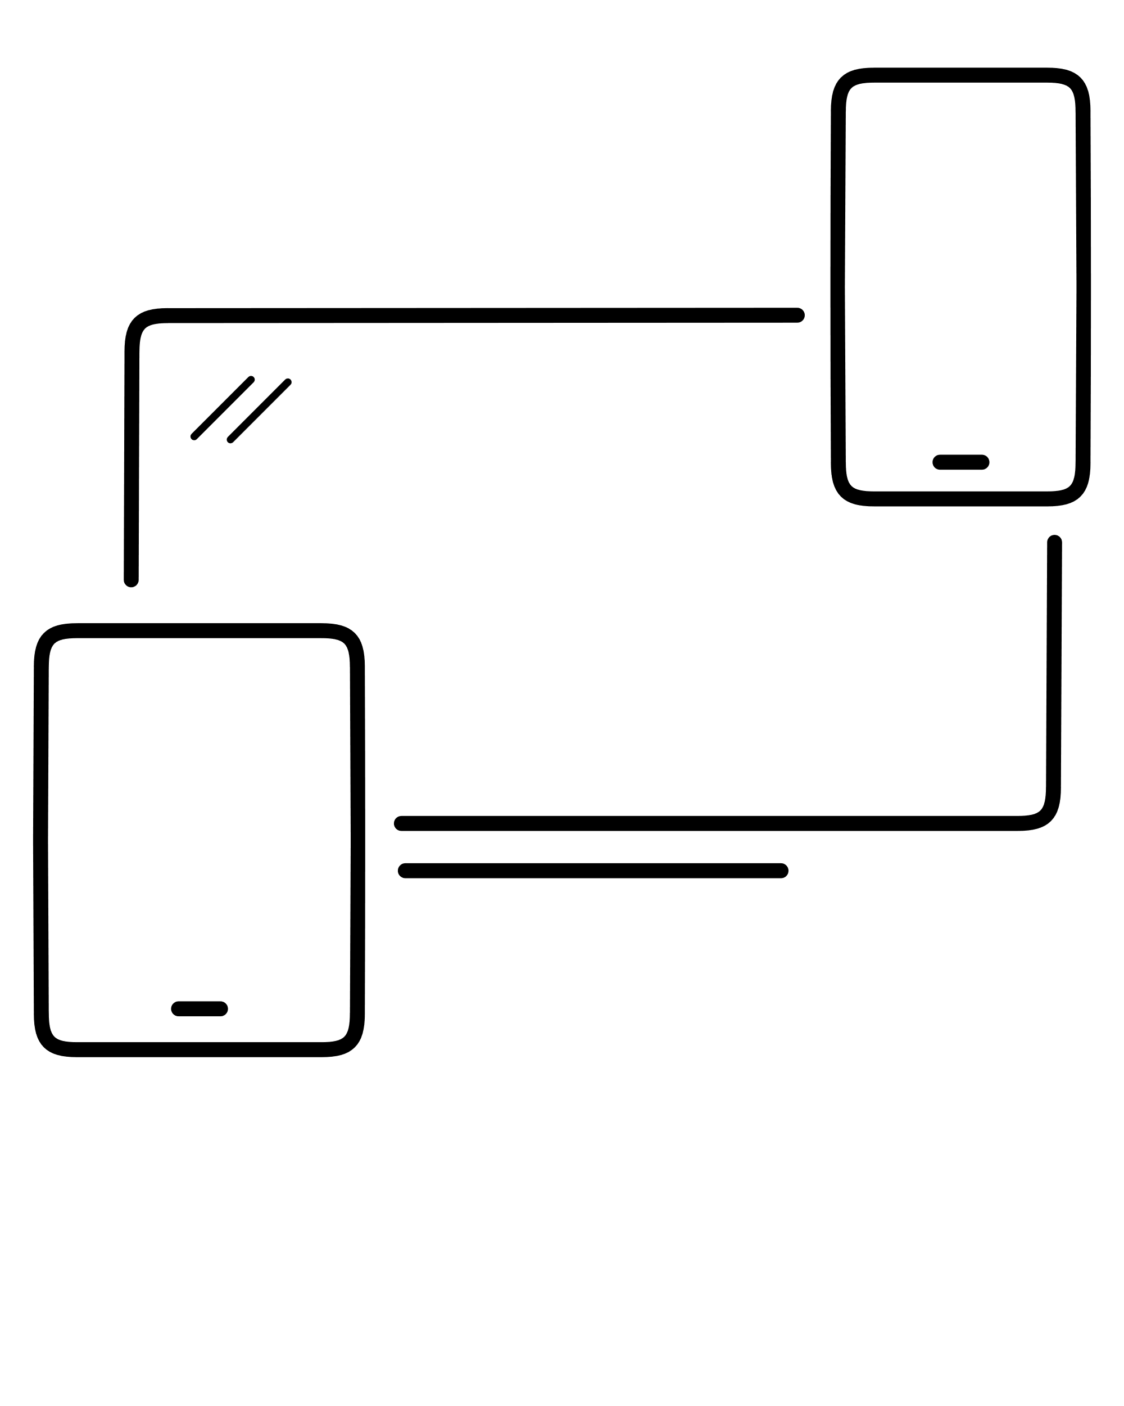


A Seminar by Saquib Akhtar on
Cross-Platform Development With Flutter
Roll No.: 59
Guide: Professor Atul Chaudhary

Slide 2
ABSTRACT
Flutter is a free and open-source cross-platform UI framework created by Google and released in May 2017. In a few words, it allows you to create a native mobile application with only one codebase. This means that you can use one programming language and one codebase to create two different apps (for iOS and Android). Besides mobile application development, flutter supports web development and desktop app development too. Since its release Using Flutter in development has given reduced code development time, increased time-to-market speed which makes it popular choice for cross-platform framework.
This year, mobile applications continued to become more and more popular. Fortunately, there are many programming tools available to developers who want to create them. Among these tools there is Flutter, which has distinguished itself lately.
When it comes to mobile application development, Flutter usage is growing significantly every year as it is highly portable and already works on many form factors beyond phones. Flutter’s popularity is easy to understand, and while half a million developers use Flutter monthly, the top five territories for Flutter developers are the US, China, India, Brazil, and the EU.
This report aims to answer questions like “What is Flutter?”, “Where it can be used?” and “Why to use Flutter?”. We discuss various factors of Flutter and the applications with their pros and cons. In the end we will discuss the future of Flutter to see what aspects of today’s mobile development world it may transform.
What is Flutter?
Flutter is an open-source UI software development kit created by Google. It is used to develop cross platform applications for Android, iOS, Linux, Mac, Windows, Google Fuchsia, and the web from a single codebase.
Original author(s) | Google
Developer(s) | Google and community
Initial release | Alpha (v0.0.6) / May 2017; 4 years ago
Stable release | 2.2.0 / 19 May 2021; 25 days ago
Written in | C, C++, Dart
Platform | Android, iOS, Google Fuchsia, Web platform, Linux, macOS and Windows
Website | flutter.dev

Slide 3
What is Flutter?
Flutter is an open-source UI software development kit created by Google. It is used to develop cross platform applications for Android, iOS, Linux, Mac, Windows, Google Fuchsia, and the web from a single codebase.
Original author(s) | Google
Developer(s) | Google and community
Initial release | Alpha (v0.0.6) / May 2017; 4 years ago
Stable release | 2.2.0 / 19 May 2021; 25 days ago
Written in | C, C++, Dart
Platform | Android, iOS, Google Fuchsia, Web platform, Linux, macOS and Windows
Website | flutter.dev

Slide 4
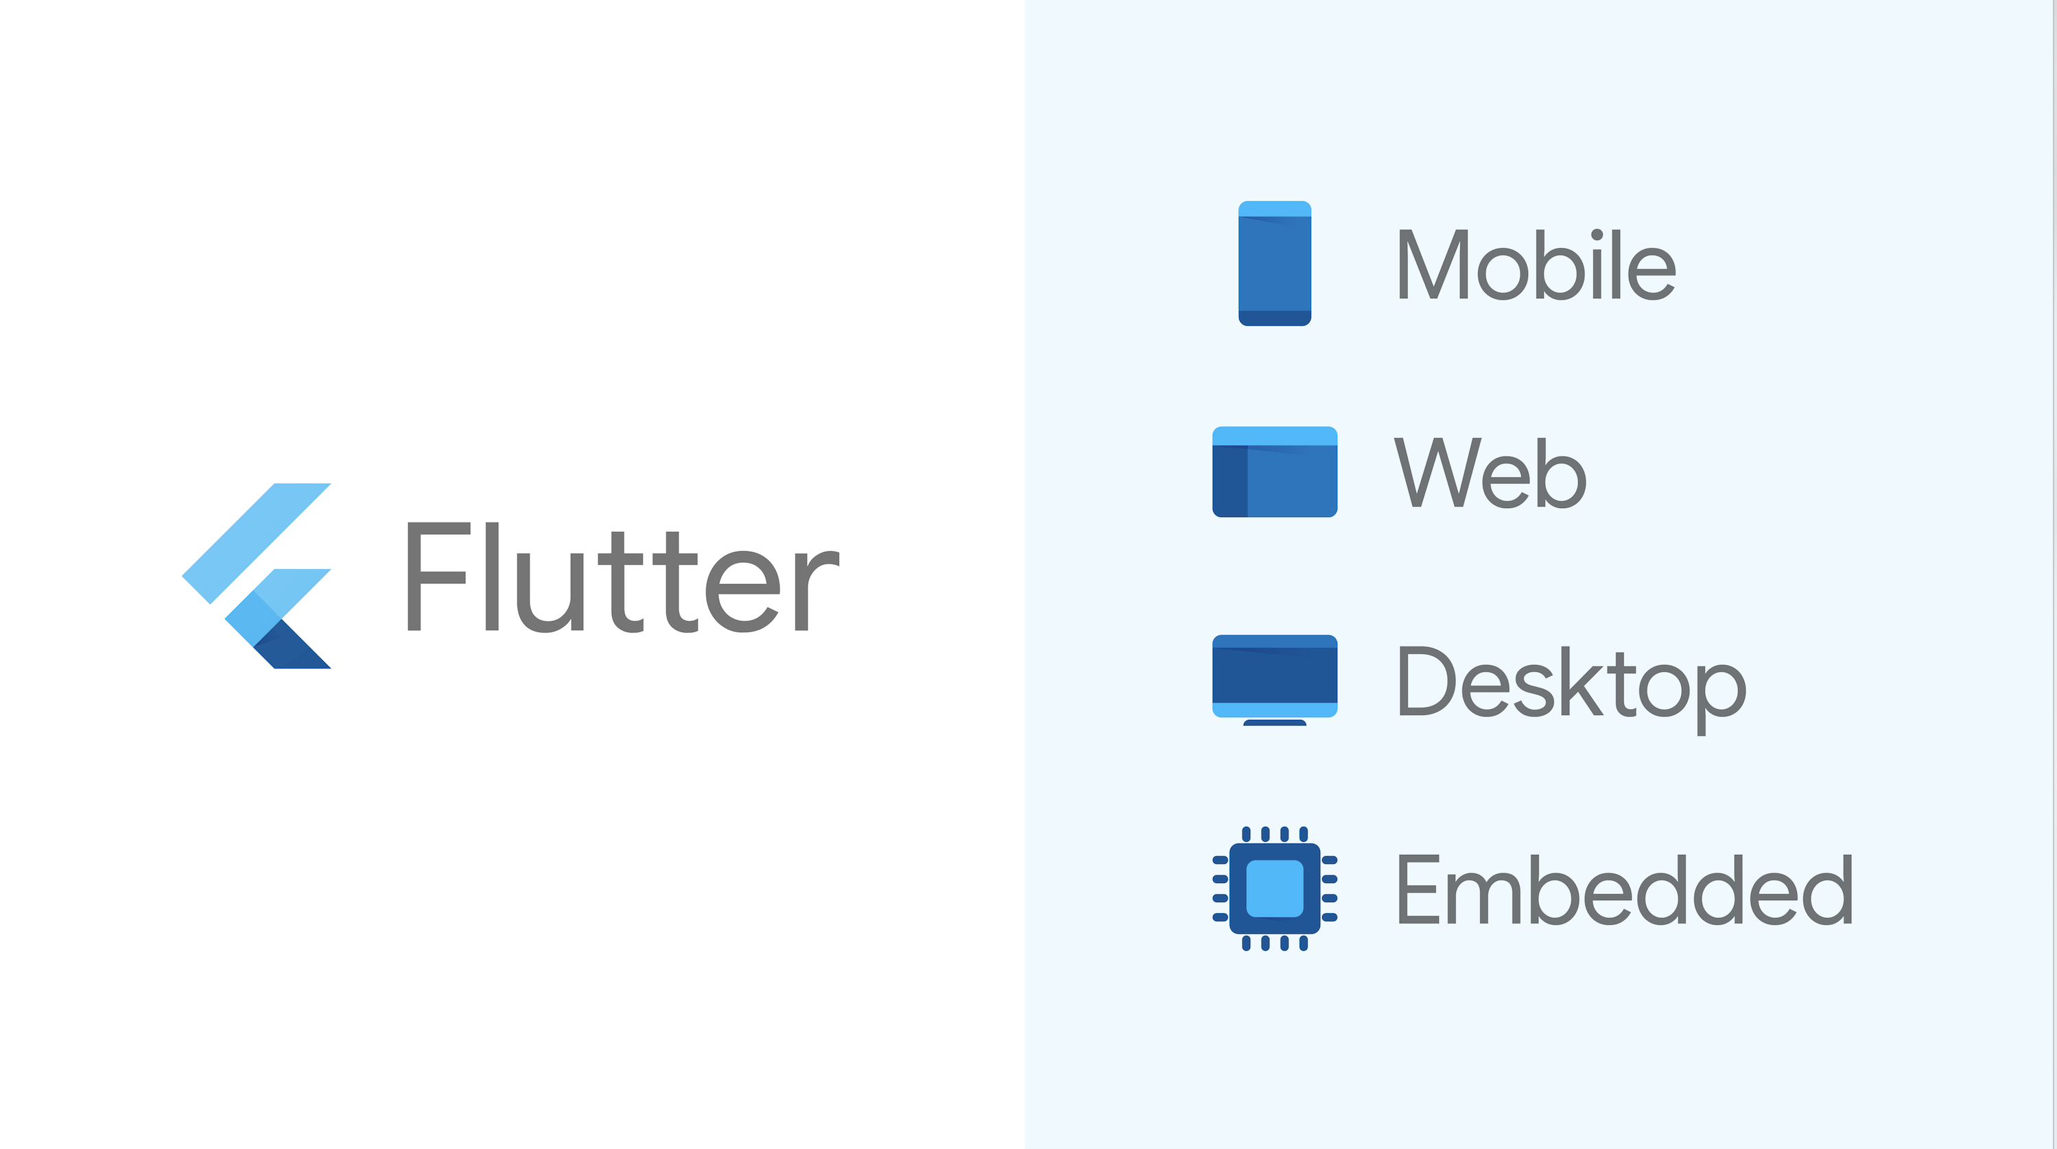
Solution For All

Slide 5
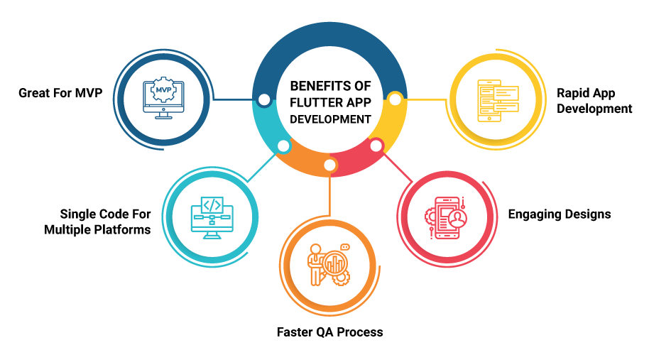
Flutter is Next Step in Cross-Platform Development

Slide 6


Why Flutter is in Dart?
OOP style language
High performance and avoids frame drop
Highly productive language, accelerates the coding process and makes the framework more attractive
Strongly typed language
Has many built in features like hot reload, code doc generation tool, tree shaking optimization etc.
Both flutter and dart are developed by google

Slide 7
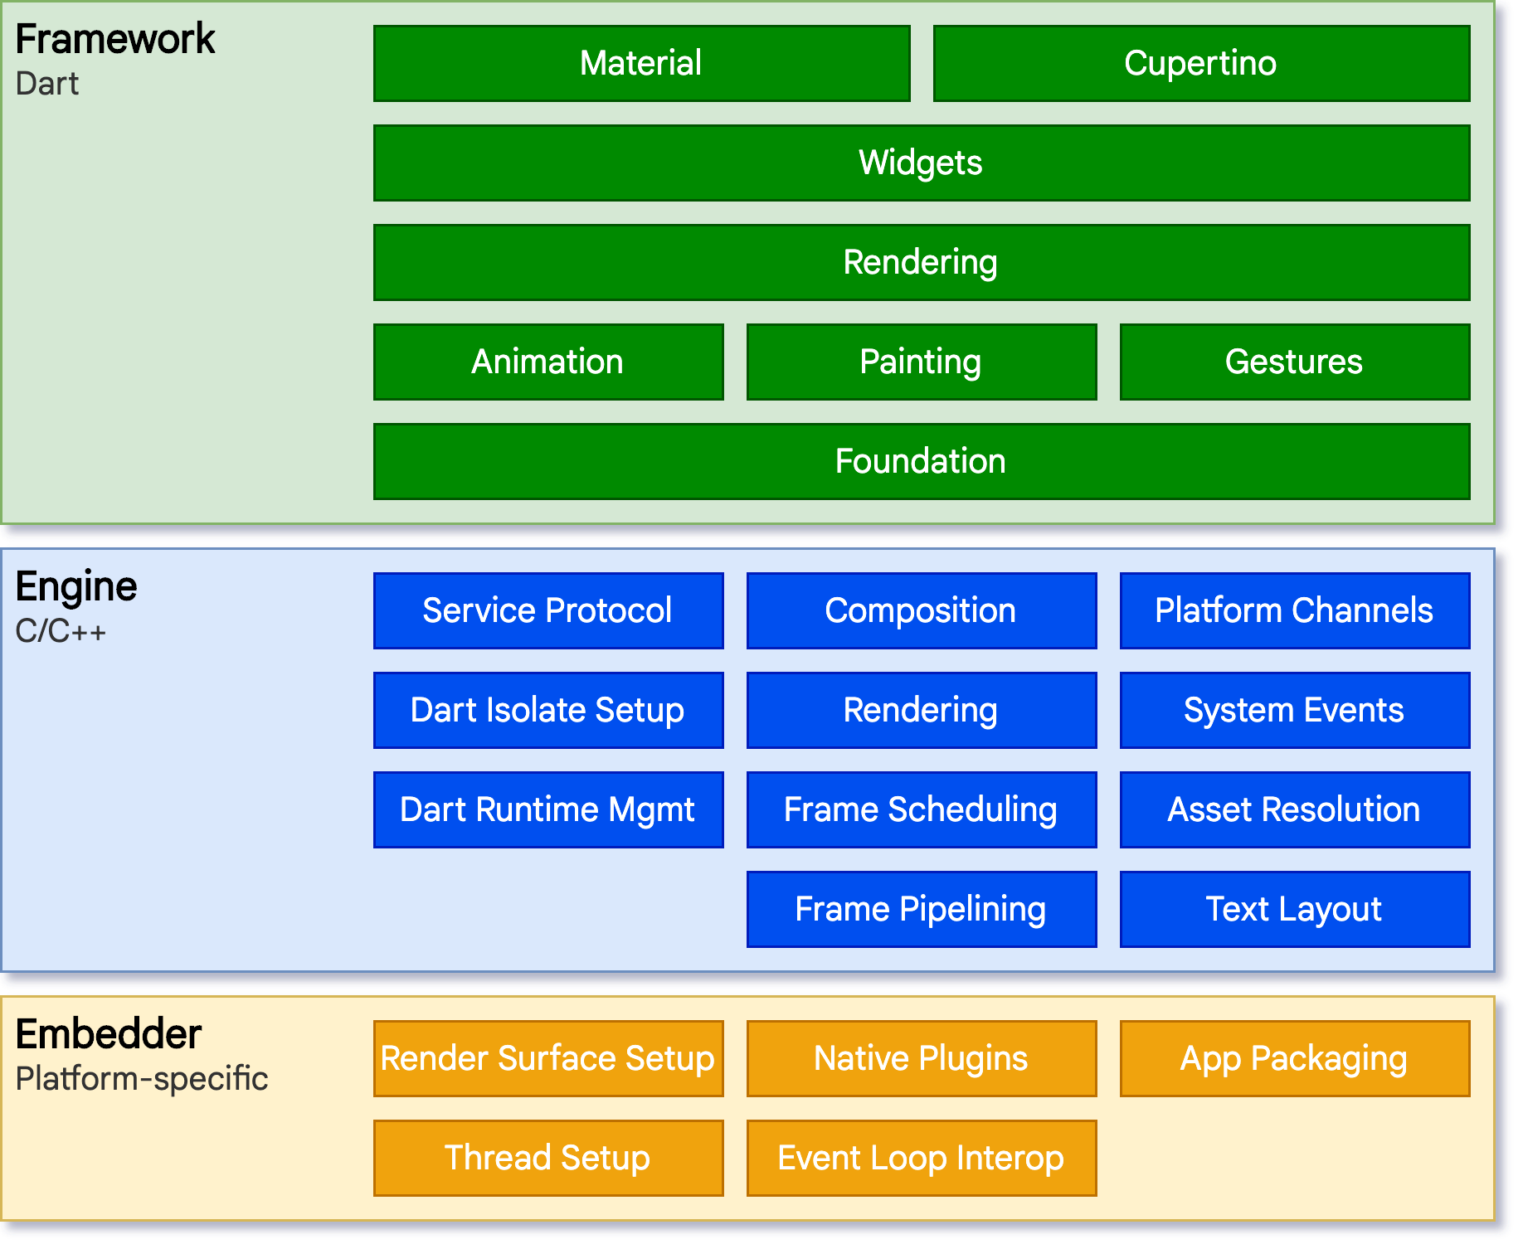
Flutter Architecture for Different OS
Developers interact with Flutter through the Flutter framework, which provides a modern, reactive framework written in the Dart language. It includes a rich set of platform, layout, and foundational libraries, composed of a series of layers.
At the core of Flutter is the Flutter engine, which is mostly written in C++ and supports the primitives necessary to support all Flutter applications. The engine is responsible for rasterizing composited scenes whenever a new frame needs to be painted
Flutter code can be integrated into an existing application as a module, or the code may be the entire content of the application.

Slide 8
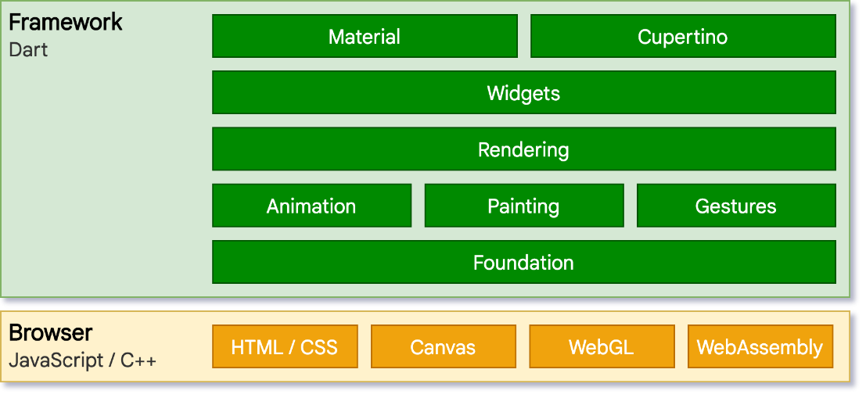
Flutter Architecture for Web
Flutter engine, written in C++, is designed to interface with the underlying operating system rather than a web browser. A different approach is therefore required. On the web, Flutter provides a reimplementation of the engine on top of standard browser APIs. We currently have two options for rendering Flutter content on the web: HTML and WebGL. In HTML mode, Flutter uses HTML, CSS, Canvas, and SVG. To render to WebGL, Flutter uses a version of Skia compiled to WebAssembly called CanvasKit. While HTML mode offers the best code size characteristics, CanvasKit provides the fastest path to the browser’s graphics stack, and offers somewhat higher graphical fidelity with the native mobile targets.

Slide 9
Why to Choose Flutter for Development Over Other Frameworks?
1. Write Once, Deploy Anywhere
Flutter gets the job done with just one codebase. Flutter makes the process extremely easy and the results extremely beautiful.
2. Hot Reload
Hot reload is a feature that lets developers make changes to the code and watch them take effect in real time. So when you’re tweaking the app or having a developer-designer collab-session, making changes and trying out new stuff is easier. You do not need to reboot the entire application to see the changes you made. Hot reload makes development several weeks faster as you spend less time performing reviews and changes.

Slide 10
Why to Choose Flutter for Development Over Other Frameworks?
3. Faster Development
Writing just one codebase to run on all platforms, various other features in Flutter aid in saving time across the development cycle. just one codebase to test, testing and debugging takes lesser time.
Flutter Development is faster than its Native Development Approaches
4. App Maintenance Is Easy Thanks To Simultaneous Android and iOS Updates
Since your Flutter app uses the same codebase across platforms, rolling out updates is another feature that becomes infinitely more seamless and simple. You can release updates for both your iOS and Android apps simultaneously,

Slide 11
Why to Choose Flutter for Development Over Other Frameworks?
5. Future Ready with Fuchsia Support
There are speculations that Google is working on a new operating system called Fuchsia which ‘could’ eventually replace android. Flutter is Fuchsia ready and you will be able to release your app of Fuchsia that day it is launched.
6. Flutter Apps Adapt To Different Screens Better
Writing apps so they fit different layouts is markedly easier in Flutter than other approaches.
7. Leverage Device Hardware
Flutter apps can use device capabilities like camera, GPS, haptic feedback and motion sensors to deliver rich experience without any lag.

Slide 12
Drawbacks of Flutter
1. Getting the Platform Specific Look and Feel
If you need your app to strictly conform to Material Design principles on Android devices, Universal Windows Platform look on Windows and Apple Design System on iOS, you may want to prepare separate applications.
2. Flutter Is a Young Technology
Released in 2018, Flutter is a young tech, and new changes are implemented too frequently in the framework which is not a good thing.
3. Flutter Apps Have Larger Size Than of Native
Apps produced using flutter have more size as compared to natives.

Slide 13

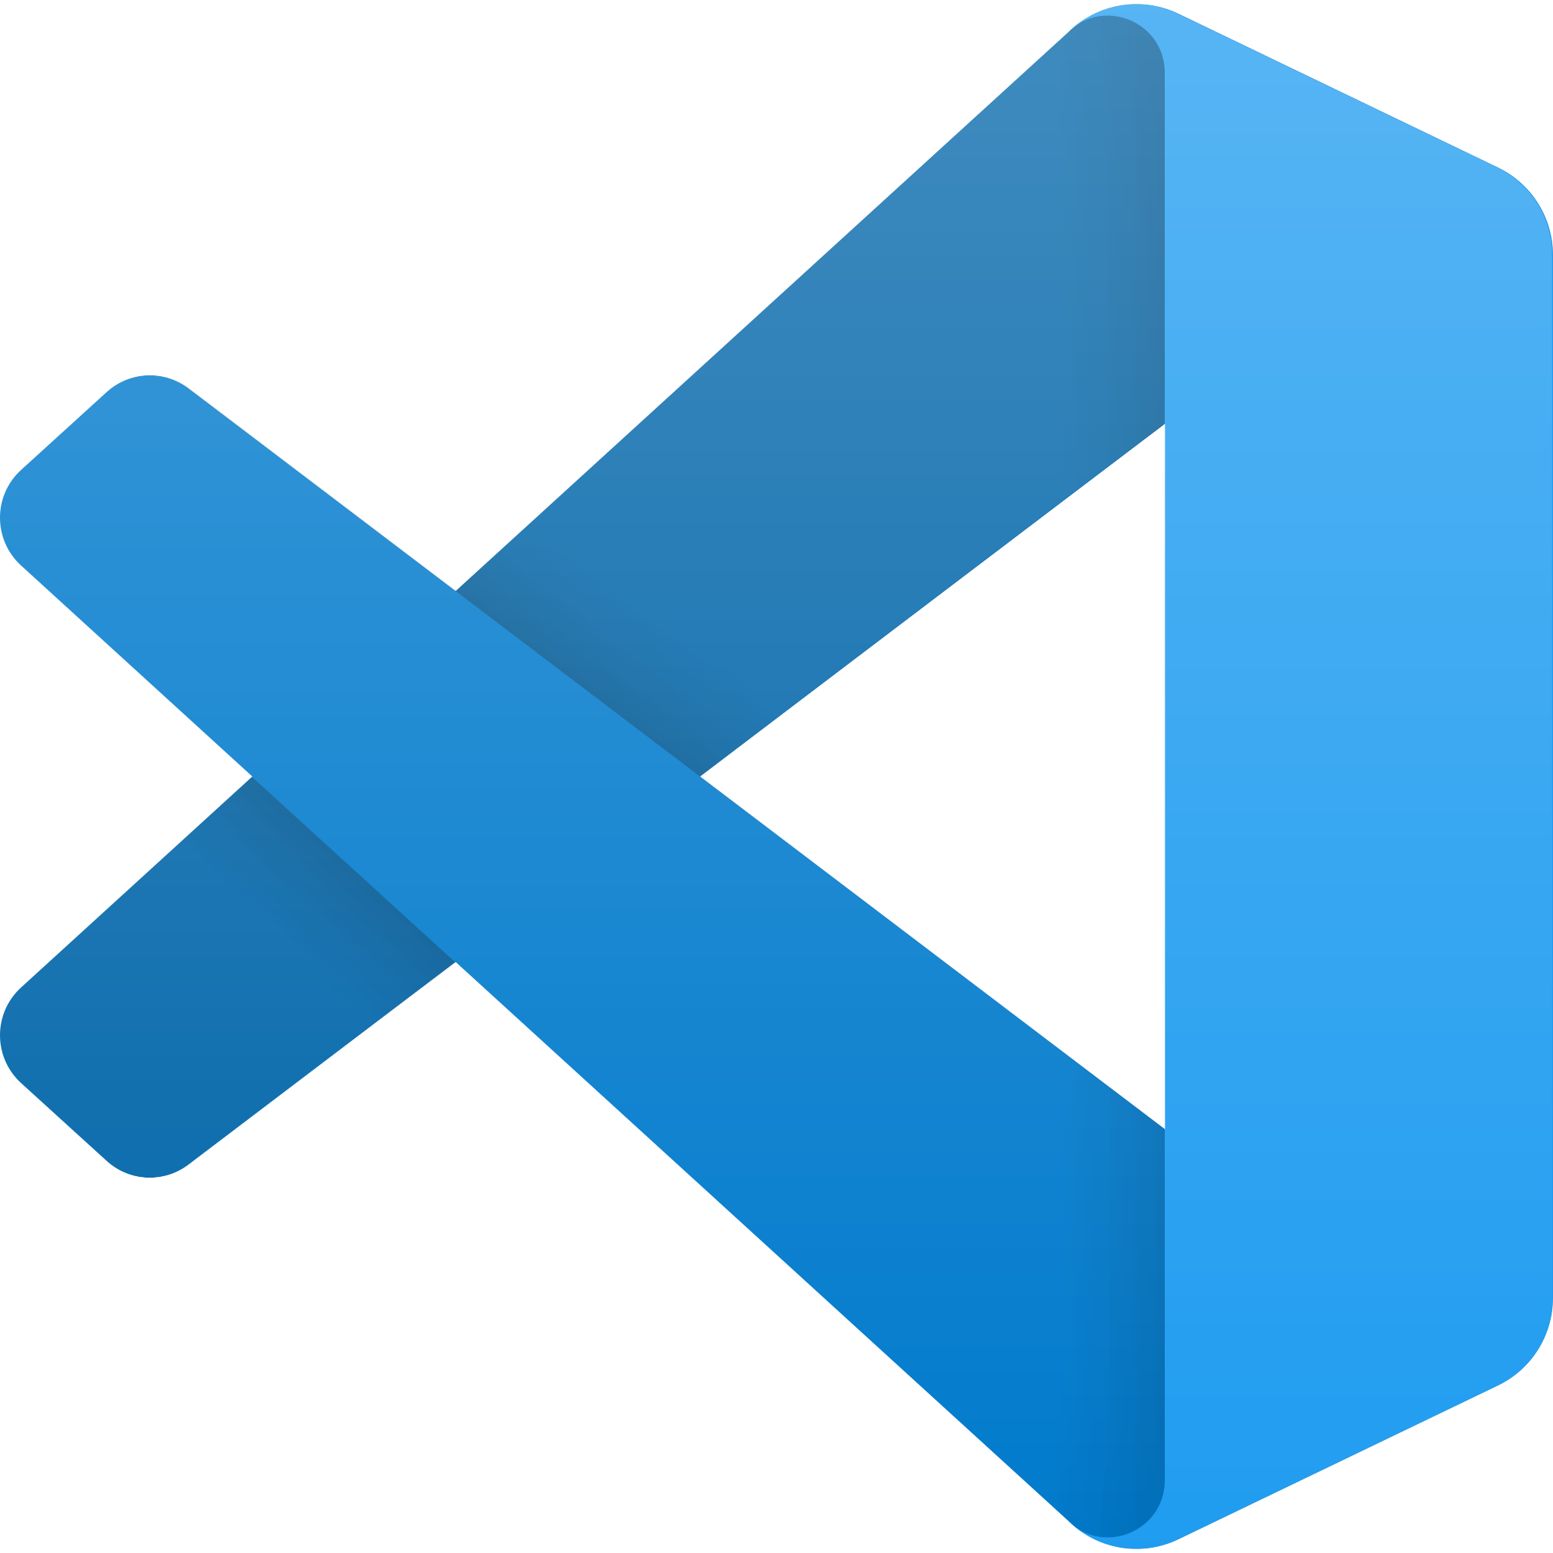
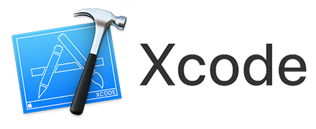
IDEs to use flutter
Visual Studio Code
Lets see a Cross-Platform Application

Slide 14
Slides after these will be in example app designed in flutter

Slide 15
Conclusion
With Flutter, the possibilities are practically endless, so even super extensive apps can be created with ease. If you develop mobile apps and have yet to give Flutter a try, I highly recommend you do. After using Flutter since it’s inception, We think its safe to say that it’s the best mobile app development technology and is the future of mobile development. If not, it’s definitely a step in the right direction.

Slide 16
Future scope
We continue to see fast growth in Flutter usage, with over two million developers having used Flutter in the last 3 years since its release. Despite these unprecedented circumstances, in March there was 10% month-over-month growth, with nearly half a million developers now using Flutter each month.
Some other interesting statistics:
60% of users are developing with Windows, 27% are using macOS, and 13% are using Linux.
35% work for a startup, 26% are enterprise developers, 19% are self-employed, and 7% work for design agencies.
The top five territories for Flutter are India, China, the United States, the EU, and Brazil.
There are approximately 90,000 Flutter apps published in the Play Store, with nearly 10,000 uploaded in the last month alone.

Slide 17
THANK YOU

